Slide 1
London 2022
Ballydown Primary School
Monday 28th – Thursday 31st March 2022

Slide 2
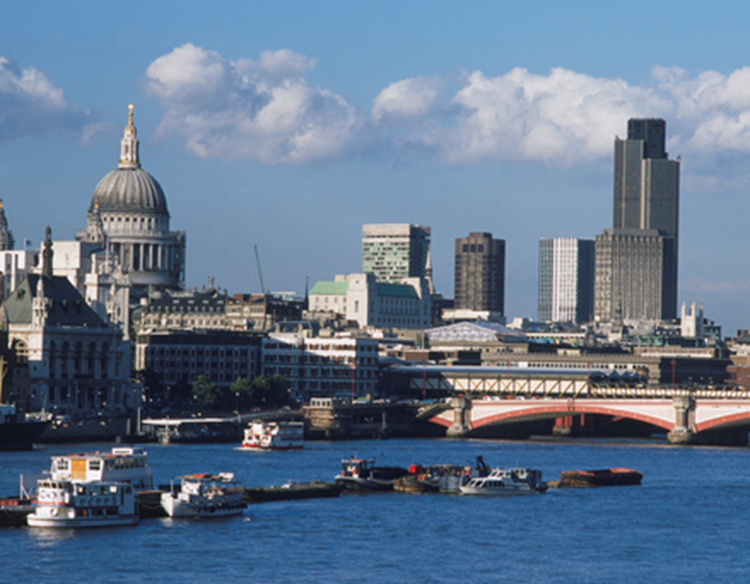
Maybe it's because I'm a Londoner, That I love London so. Maybe it's because I'm a Londoner That I think of her, wherever I go. I get a funny feeling inside of me Just walking up and down. Maybe it's because I'm a Londoner That I love London Town.

Slide 3
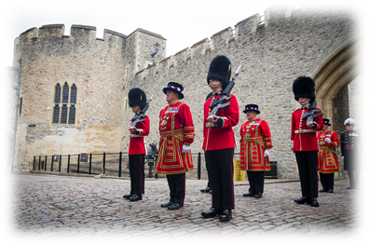
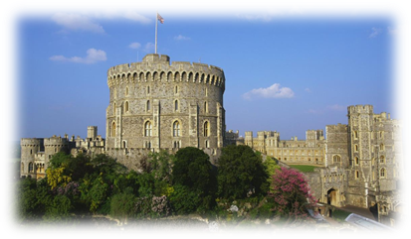
Day 1 – Monday 28th March 2022
Arrive @ school from 06:15
Depart school on coach at 06:30
Depart from Belfast City Airport (BHD) at 08:55
Arrive at London Heathrow (LHR) at 10:15 [EI 930]
Pupils will need a packed lunch today!
12:00 Windsor Castle
17:00 Check in Ramada London North
19:30 Ten Pin Bowling at Hollywood Bowl

Slide 4
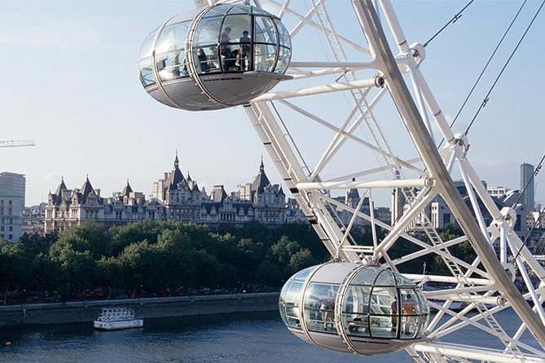
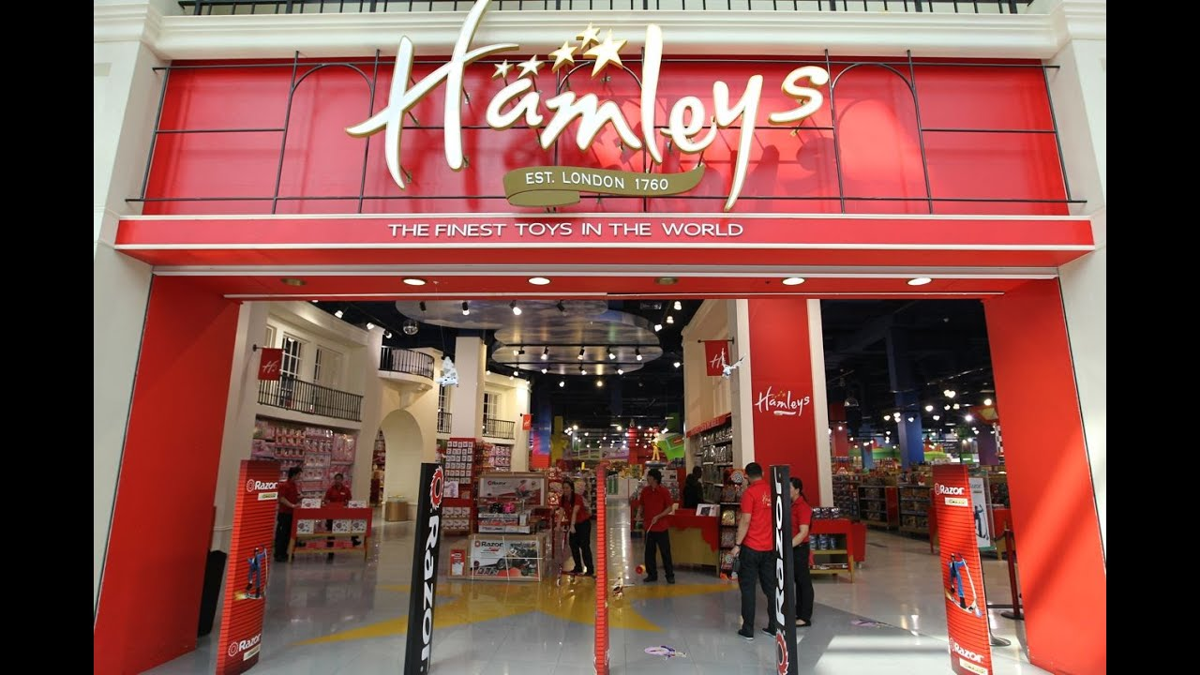
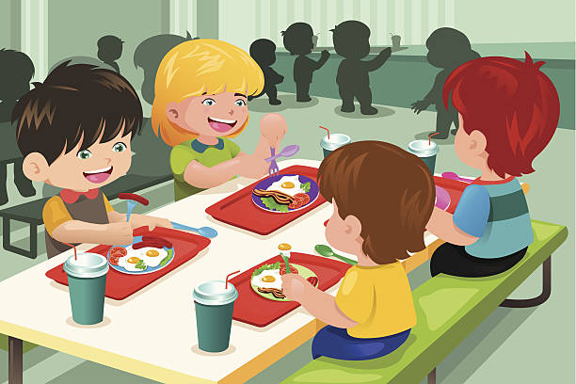
Day 2 – Tuesday 29th March
Rise & Shine – Breakfast 07:30
10:00 Visit the Houses of Parliament, Westminster Abbey, Whitehall
12:45 London Eye
13:30 Hamleys Shopping
17:20 Dinner at Pizza Express
Evening walk to Buckingham Palace

Slide 5
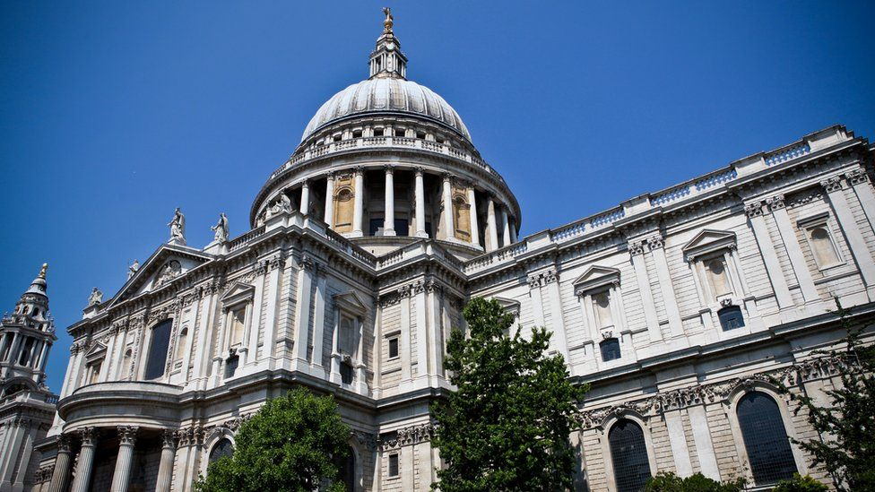
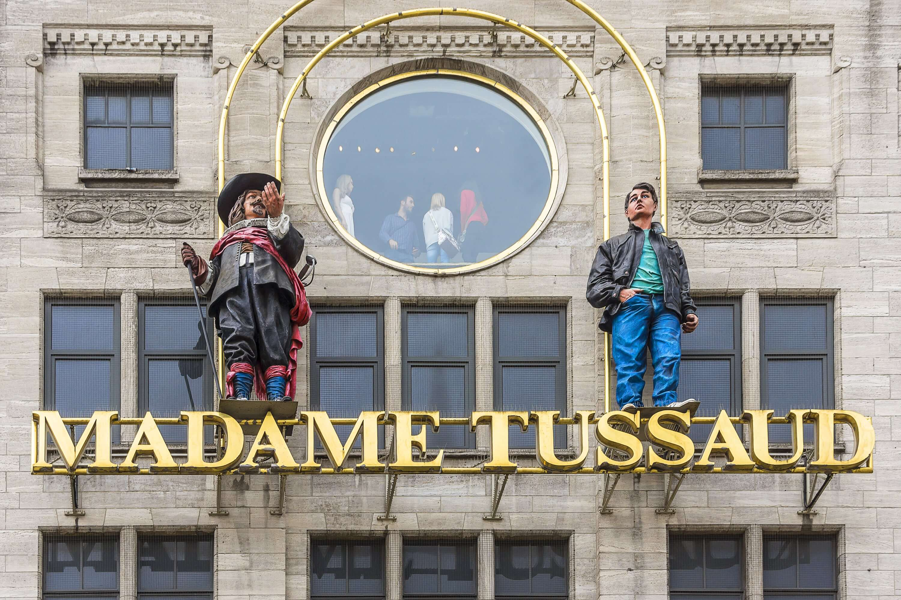
Day 3 – Wednesday 30th March 2022
Rise & Shine – Breakfast 07:45
09:45 Madame Tussauds
12:30 Lunch
14:00 Matilda (Matinee Performance)
18:00 Dinner at Rainforest Cafe
19:00 Evening walk along the South Bank viewing

Slide 6
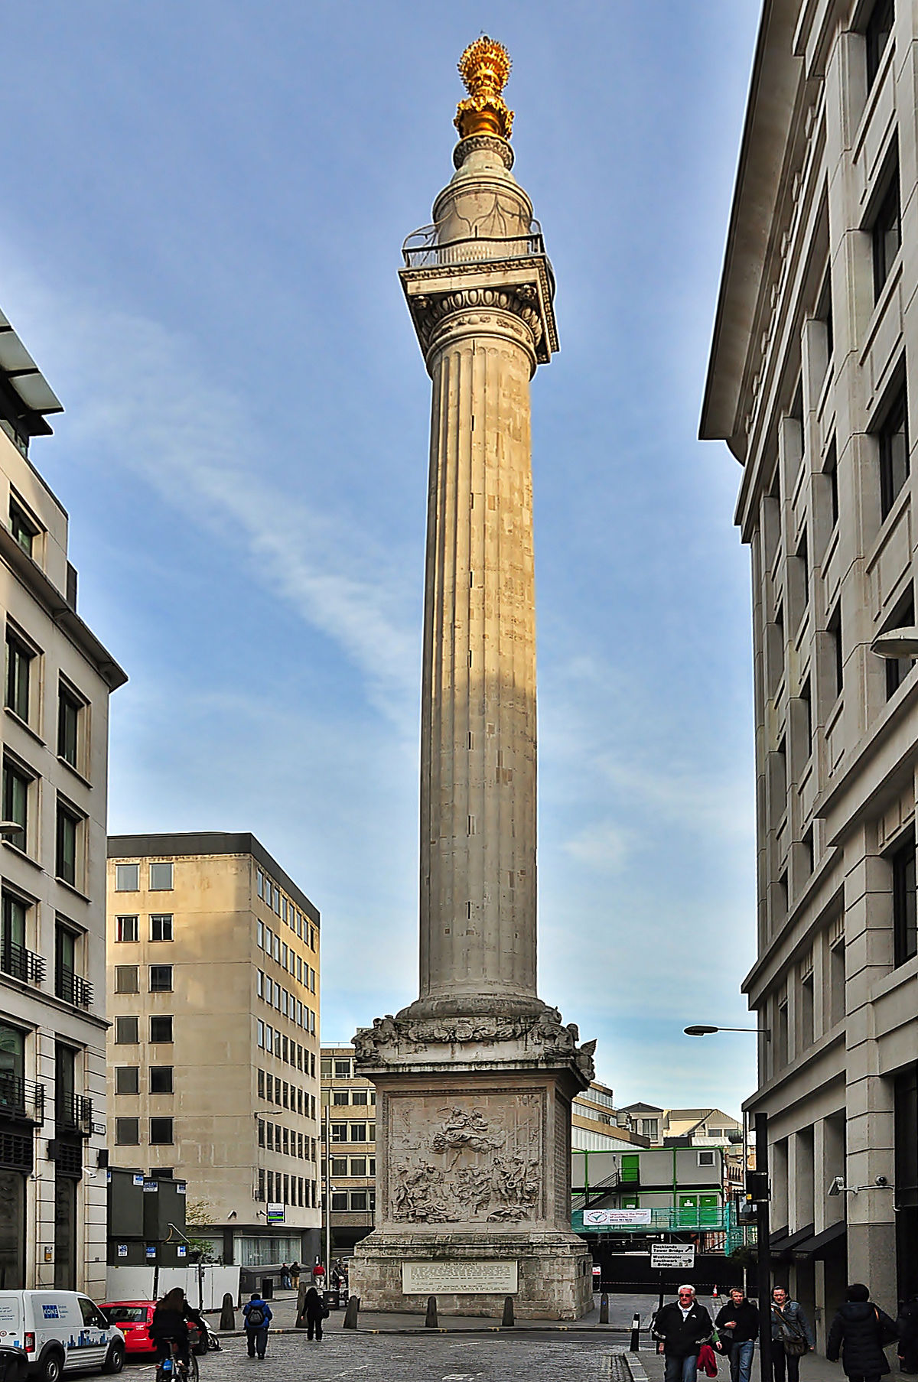
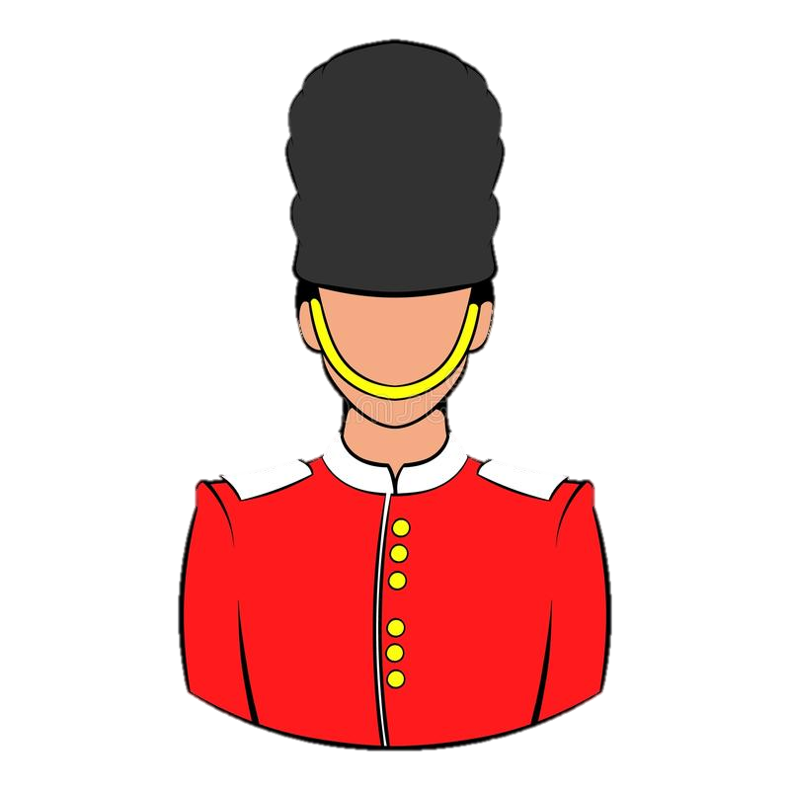
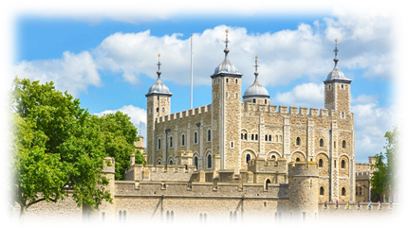
Day 4 – Thursday 31st March
Rise & Shine Breakfast 07:30
Great Fire of London Monument
10:00 Tower of London
Lunch
Depart London Heathrow at 19:40
Arrive Belfast City Airport (BHD) at 21:05 [EI 937]
Arrive @ school 21:45

Slide 7
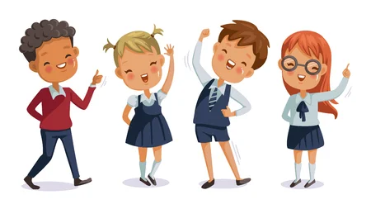
Not take unnecessary risks;
Follow instructions of the group leader, teachers, instructors and guides within the venues;
Adhere to the school’s code of conduct contract;
Be aware of anything that may cause themselves or others harm, speak to their group leader or teacher if they are concerned.
Pupils Will…

Slide 8
Do their best to ensure the health and safety of everyone in the group;
Act as any reasonable parent would in the circumstances;
Take reasonable steps to avoid exposing pupils to dangers that are foreseeable and beyond those that the pupils can reasonably be expected to cope with;
Inform and update parents on the tours progress
Accompanying teachers will…

Slide 9
Other Information…
Cabin Case - Baggage size: 10kg - (Maximum size: 55cm x 40cm x 24cm)
Money (£40 - £50)
Telephone (No Mobiles permitted)
Personal items labelled
Behaviour (Signed contract)
Security
Confidential Information
Passports sent into school (a.s.a.p.)

Slide 10
Group List
Mr Murphy Ms Gordon | Mr Russell | Mrs Blair | Mrs McDonald
James Hare James Bowman Robin Nelson Callum Elliott Molly McCrory Maisie Nichol Eva Gillham Poppy Smyth Ava McGrath Edie Scott (10) | Adam Green Jacob Anderson Joseph Brown Jude Madeley David Rogers Alfie Brown Finlay Mathers William Shannon Oscar White Elliott Clarke Bryson McClelland Charlie Crawford (12) | Catherine Hughes Eva Carson Lilly Woods Penny Gibson Sarah Martin Kerry McVeigh Jude Porter Isaac McCrum Michael Toal (9) | Poppy Walsh Ellen Doran Sophie Little Alicia Jeffers Abigail Roke Lily McCracken Sophie McClintock Olivia Shaw Eva McKay (9)

Slide 11
London Rooms
19 Boys
TRIPLE | Adam Green | Jacob Anderson | Joseph Brown
TRIPLE | Jude Madeley | David Rogers | Alfie Brown
TRIPLE | Finlay Mathers | William Shannon | Oscar White
TRIPLE | Jude Porter | Isaac McCrum | Michael Toal
TRIPLE | Elliott Clarke | Bryson McClelland | Charlie Crawford
DOUBLE | James Hare | James Bowman
DOUBLE | Callum Elliott | Robin Nelson
21 Girls
TRIPLE | Poppy Walsh | Ellen Doran | Sophie Little
TRIPLE | Alicia Jeffers | Abigail Roke | Lily McCracken
TRIPLE | Sophie McClintock | Olivia Shaw | Eva McKay
TRIPLE | Catherine Hughes | Eva Carson | Lilly Woods
TRIPLE | Penny Gibson | Sarah Martin | Kerry McVeigh
TRIPLE | Molly McCrory | Maisie Nichol | Eva Gillham
TRIPLE | Poppy Smyth | Ava McGrath | Edie Scott
5 TEACHERS & 1 COACH DRIVER
SINGLE | Mr Murphy
SINGLE | Mr Russell
SINGLE | Mrs Blair
SINGLE | Ms Gordon
SINGLE | Mrs McDonald
SINGLE | Driver

Slide 12
